Slide 1
Your First Typescript Program

Slide 2
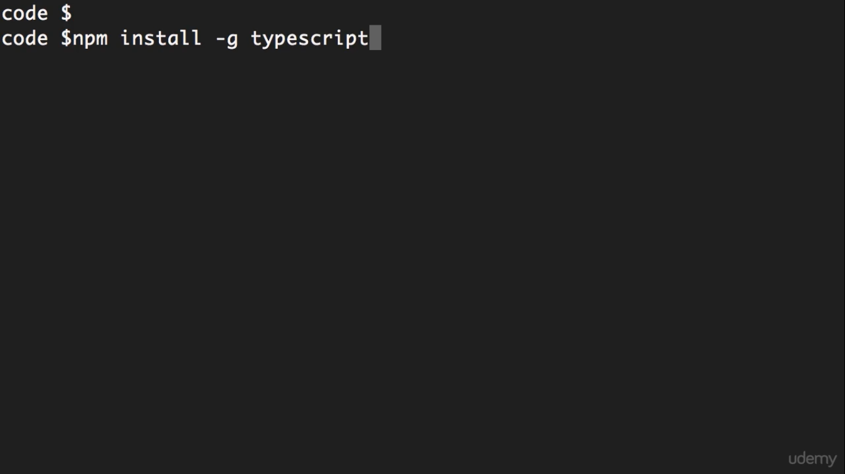

Slide 3
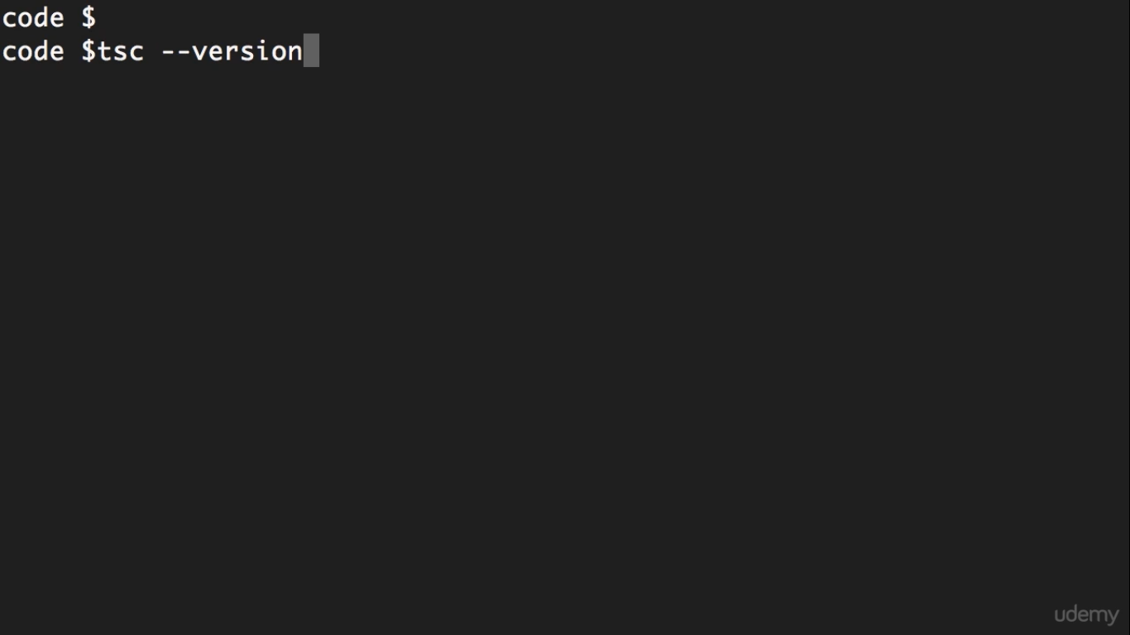

Slide 4
